Slide 1

Embedded System Projects using Arduino (EET 4109)
End-Term Project Presentation on
Arduino Based Automatic Plant Watering System with Environmental Monitoring
Presented by
Mr. Anirban Chatterjee
Mr.Suayush Kumar Das
Mr.Chandra Sekhar Acharya
Supervisor
Dr. Sandhyalati Behera
Department of Electronics and Communication Engineering
Institute of Technical Education & Research (FET)
Siksha ‘O’ Anusandhan Deemed to be University, Bhubaneswar

Slide 2
Contents
Introduction
Literature Survey
Design Scheme
Testing, Analysis, And Evaluation
Socio-economic Issues Associated With The Project
Engineering Tools And Standards
Conclusion

Slide 3
Introduction
Water scarcity and inefficient irrigation practices pose significant challenges in agriculture and household gardening. Manual watering often leads to overwatering or underwatering, resulting in poor plant health and unnecessary wastage of water. With the advancement of embedded systems and sensor technology, automated irrigation solutions have become more efficient and reliable. This project focuses on the design and implementation of an Arduino-based Automatic Plant Watering System that continuously monitors soil moisture, temperature, humidity, and water tank level. Based on real-time sensor data, the system automatically controls a water pump to supply water only when required. An LCD displays live system status, while a buzzer and LED provide audio-visual alerts. The proposed system aims to reduce human intervention, ensure optimal plant growth, and promote efficient utilization of water resources.

Slide 4
Literature Survey
Various automatic irrigation systems have been proposed using microcontrollers and sensors. Traditional timer-based irrigation systems lack adaptability to environmental conditions, often leading to water wastage. Sensor-based irrigation techniques using soil moisture sensors have shown improved efficiency by watering plants only when soil moisture falls below a threshold.
Previous studies have incorporated temperature and humidity sensors such as DHT series sensors to monitor climatic conditions. Ultrasonic sensors have also been used for water level detection in storage tanks to prevent dry running of pumps. Recent implementations focus on low-cost, Arduino-based systems suitable for small-scale agricultural and domestic applications.
Based on the literature, integrating multiple sensors with real-time monitoring and automated control provides a reliable and efficient irrigation solution, which forms the foundation of this project.

Slide 5
Design Scheme
The system is designed around an Arduino UNO microcontroller. Soil moisture sensor, DHT sensor, and ultrasonic sensor act as input devices. The soil moisture sensor measures water content in soil, while the DHT sensor monitors temperature and humidity. The ultrasonic sensor measures the water level in the tank.
Based on sensor inputs, the Arduino processes data and controls output devices such as a relay-controlled water pump, LCD display, LED indicator, and buzzer. The relay isolates the low-power control circuit from the high-power pump circuit, ensuring electrical safety.
The design ensures automatic operation, safety against water shortage, and user-friendly monitoring through visual and audio feedback.

Slide 6
Design Scheme
Working Principle
The system continuously monitors soil moisture, temperature, humidity, and water tank level.
Sensor data is processed by the Arduino Uno to determine irrigation requirements.
When soil moisture falls below the defined threshold (60%), the relay activates the water pump.
Once sufficient moisture is achieved, watering stops automatically and an alert is generated.
The LCD provides real-time system status and sensor readings.

Slide 7
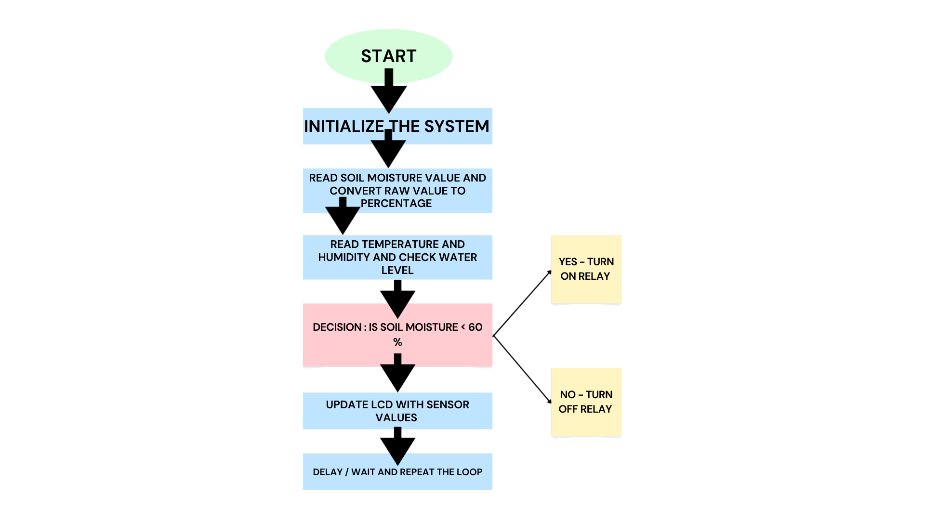
Design Scheme
Flow Chart

Slide 8
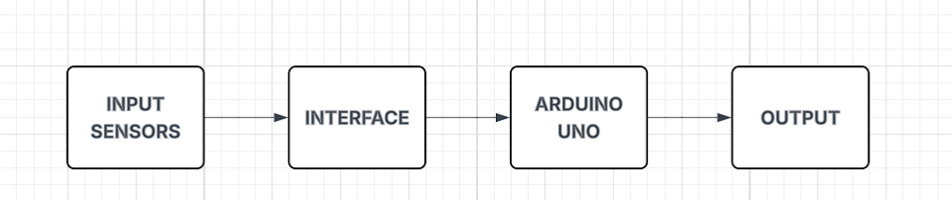
Design Scheme
Block Diagram
INPUT SENSORS
The soil moisture sensor measures the water content present in the soil.
The DHT22 sensor provides real-time temperature and humidity information.
The ultrasonic sensor measures the water level in the storage tank.
These sensors convert physical parameters into electrical signals for further processing.

Slide 9
Design Scheme
2.INTERFACE
The interface block acts as a bridge between the sensors and the microcontroller.
Analog sensor outputs are converted into digital values using the Arduino’s ADC.
Proper voltage levels and signal compatibility are ensured in this stage.
This block enables reliable data transfer to the processing unit.
3.ARDUINO UNO
Arduino Uno functions as the central control and decision-making unit.
It continuously reads sensor data and executes the programmed control logic.
The microcontroller compares soil moisture values with a predefined threshold.
Based on the comparison, appropriate control signals are generated.

Slide 10
Design Scheme
4. OUTPUT
This block performs physical actions based on the control signals from Arduino.
The relay module controls the water pump to automate irrigation.
The buzzer provides audio alerts for system status and watering conditions.
The I2C LCD displays real-time sensor values and system messages.

Slide 11
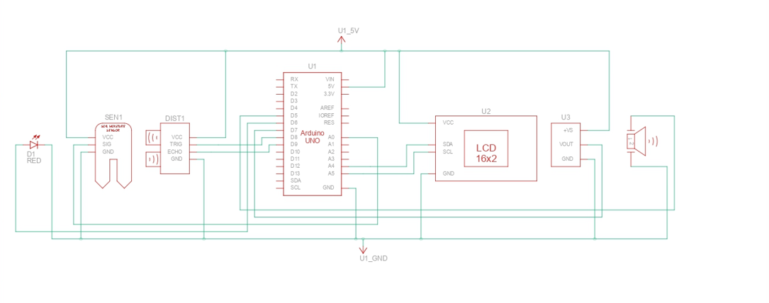
Design Scheme
SCHEMATIC:

Slide 12
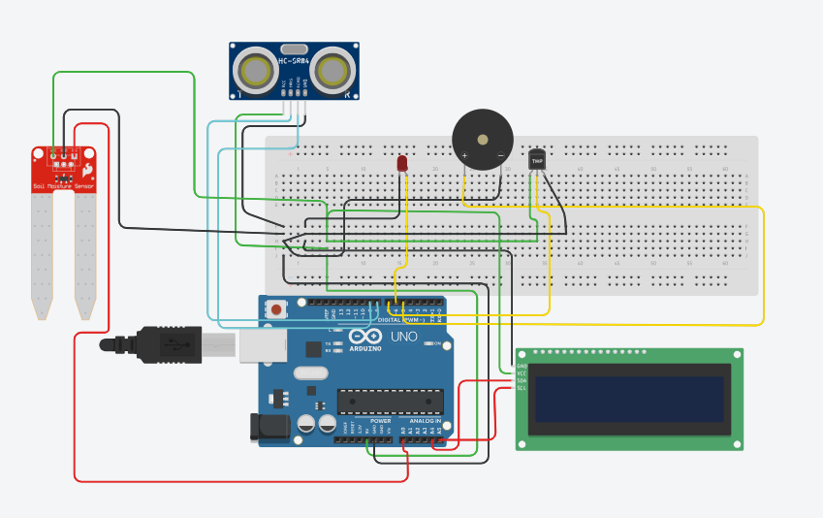
Design Scheme
CIRCUIT:

Slide 13
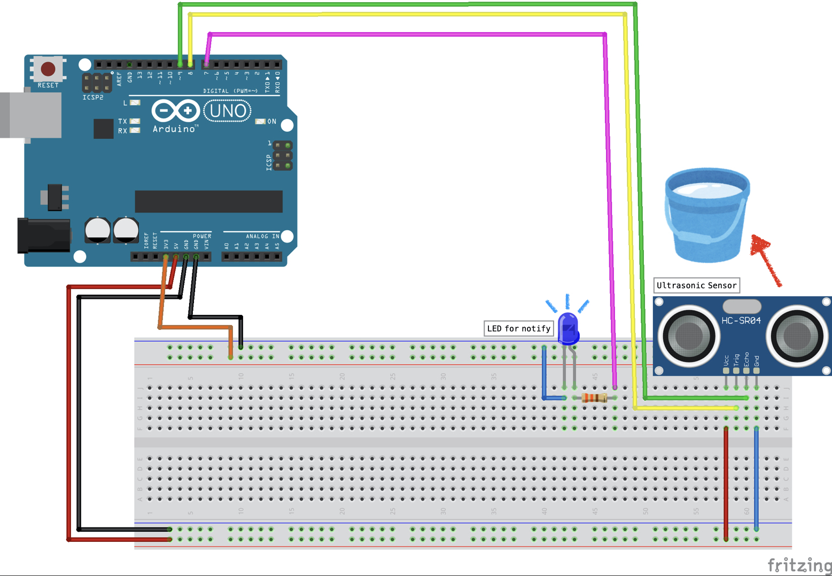
Design Scheme

Slide 14
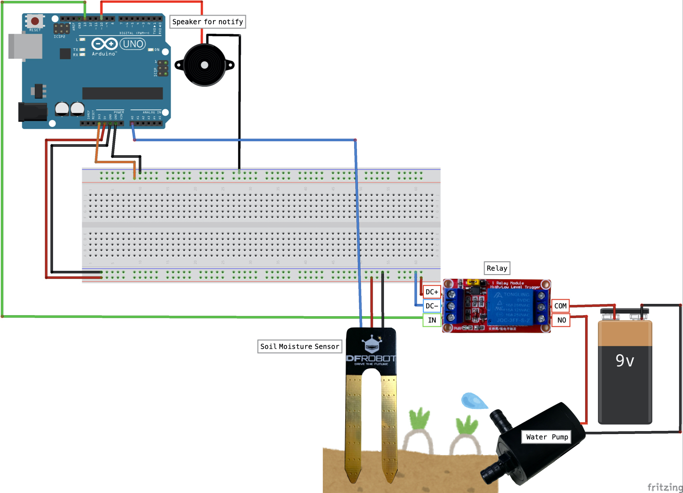
Design Scheme

Slide 15
Testing (Breadboard Implementation)
The entire system was first implemented and tested on a breadboard to verify individual component functionality. Each sensor was tested independently using separate Arduino test programs to confirm correct readings. The soil moisture sensor output was observed through the serial monitor, while DHT sensor readings were verified for temperature and humidity accuracy.
The ultrasonic sensor was tested by measuring known distances to ensure proper water level detection. Output devices such as the relay module, LED, and buzzer were tested individually before integration. After successful individual testing, all components were interconnected on the breadboard and the complete system was tested under controlled conditions.
This step-by-step testing approach ensured reliable system operation and reduced integration errors.

Slide 16
Results, Analysis and Evaluation
The implemented system successfully monitored soil moisture, temperature, humidity, and water tank level in real time. The water pump automatically activated when soil moisture dropped below the predefined threshold and deactivated once adequate moisture was achieved. The ultrasonic sensor effectively prevented pump operation when the water tank level was low.
The LCD display provided continuous system status, while the LED and buzzer offered clear visual and audio alerts. The system demonstrated reduced water wastage, improved watering accuracy, and minimal human intervention. Overall, the project met all design objectives and performed reliably under various test conditions.

Slide 17
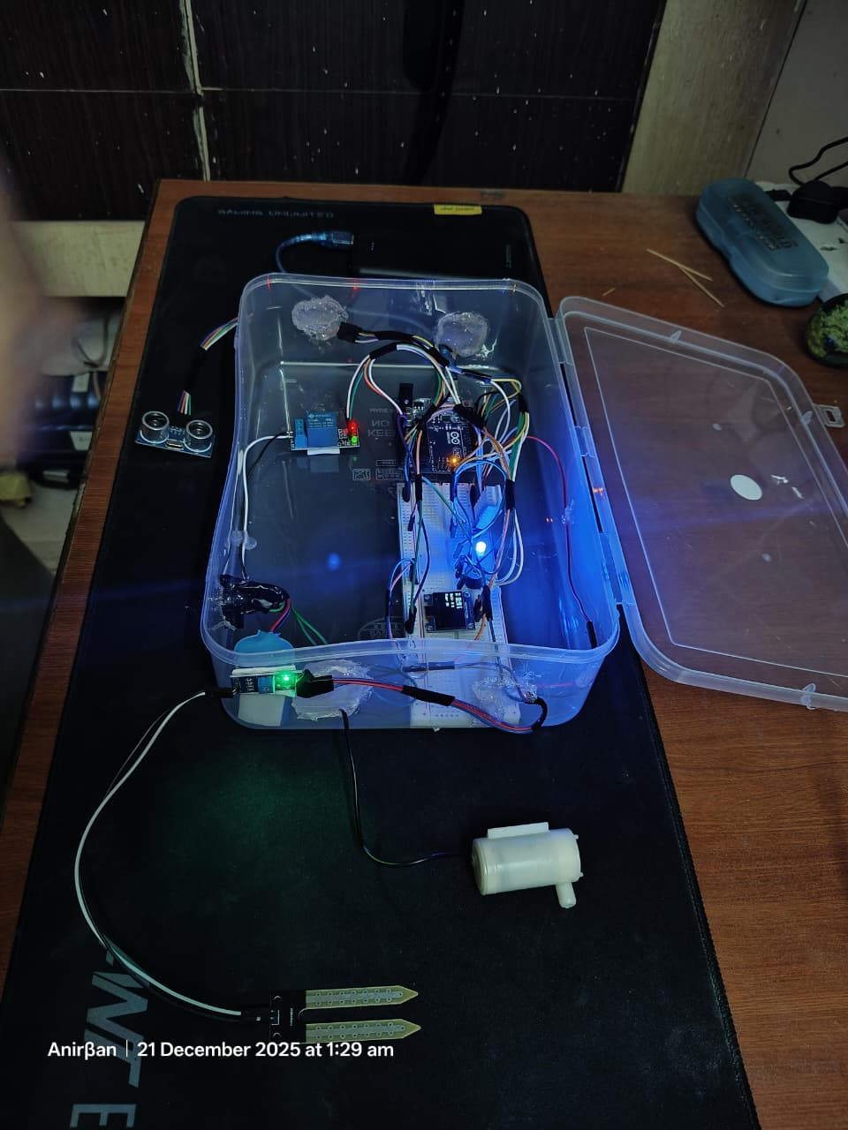
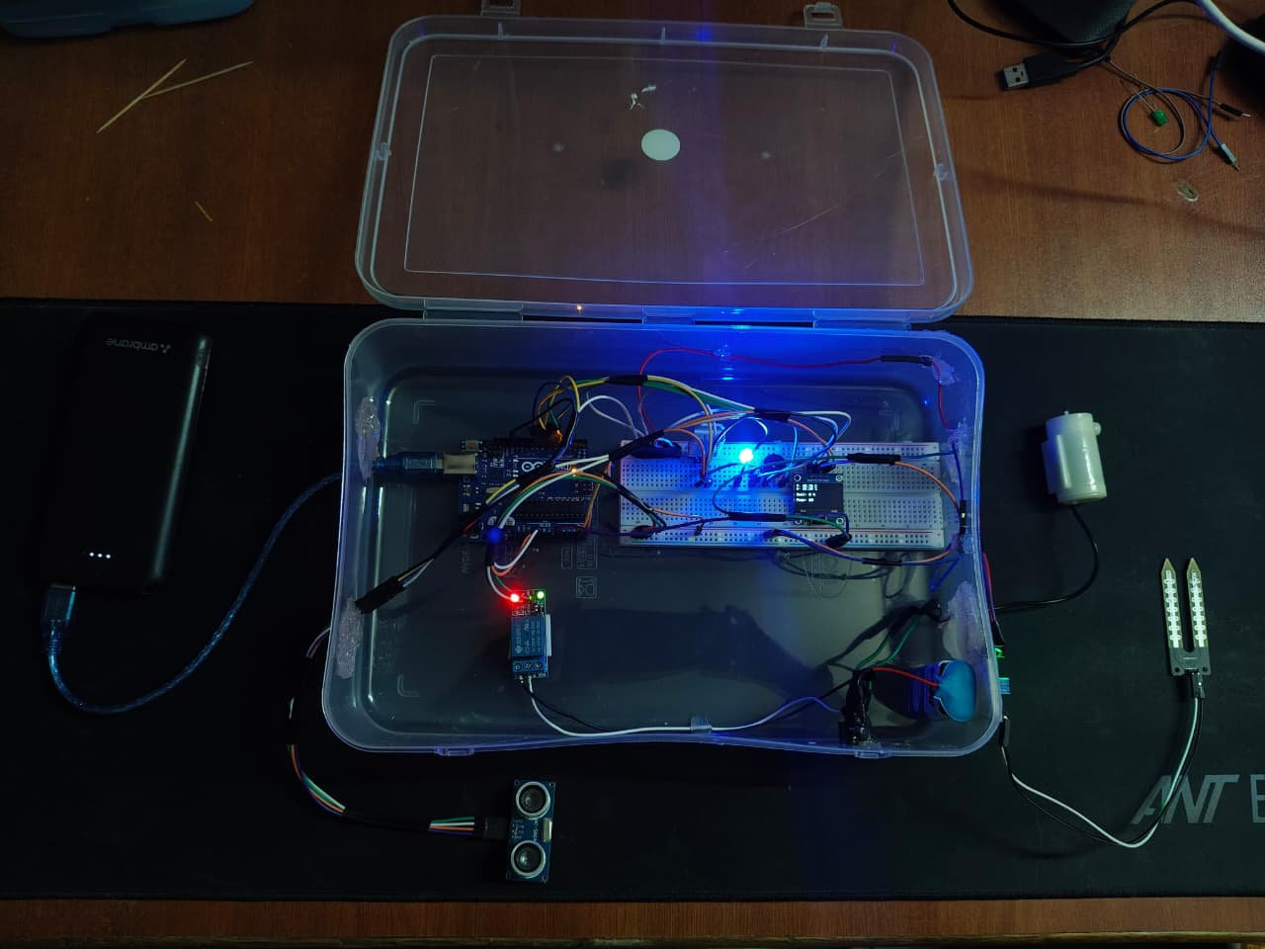
Results, Analysis and Evaluation

Slide 18
Socio-economic Issues Associated With The Project
The proposed system contributes positively to society by promoting water conservation, which is crucial in water-scarce regions. It reduces dependency on manual labor, making it suitable for elderly users and small-scale farmers. The low-cost nature of the system ensures affordability and accessibility.
Economically, the system minimizes water and electricity wastage, leading to long-term cost savings. It supports sustainable agriculture practices and can improve crop yield by ensuring optimal watering conditions. The project aligns with environmental sustainability goals and smart agriculture initiatives.

Slide 19
Engineering Tools And Standards
The project was developed using standard engineering tools and practices. Arduino IDE was used for embedded software development following structured programming principles. Sensors and modules were interfaced according to their datasheet specifications and voltage standards.
Standard communication protocols such as I²C were used for LCD interfacing. Electrical safety was ensured by using relay isolation for motor control. Component selection adhered to low-voltage embedded system standards, ensuring system reliability, safety, and scalability.

Slide 20
Conclusion
An automatic plant watering system using Arduino was successfully designed and implemented. The system efficiently monitors soil and environmental conditions and performs automated irrigation based on real-time data. The inclusion of water level detection, visual display, and alert mechanisms enhances system reliability and usability.
The project demonstrates the effective application of embedded systems in smart irrigation and serves as a practical solution for efficient water management in domestic and small-scale agricultural environments.

Slide 21
References
Arduino Official Documentation, https://www.arduino.cc
Datasheets of DHT11/DHT22 Sensors
HC-SR04 Ultrasonic Sensor Datasheet

Slide 22


